Slide 1

24IT504L - MINI PROJECT-I
Batch Number: 10
A Real-Time Air Quality and Carbon Emission Monitoring System for Smart Campus Using IoT
Team Members:
Supervisor:
Mr .A. Duraimurugan, M.E.,
Assistant Professor / IT
Logeshwar S
Mohanraja V
Sriram G
621324205026 621324205034 621324205057
Review - 0

Slide 2
Contents
S.No | Table Of Contents | Page No
1 | Project Title | 3
2 | Type Of Project | 3
3 | Existing Solutions | 4
4 | Motivation And Gap | 7
5 | Project Requirements | 8
6 | Objectives | 11
7 | Expected Outcomes | 12
8 | SDG Number, Global Challenges and Its Justification | 13
9 | Project Domain and Mapping with Pos /PSOs with Justification | 14
10 | Conclusion | 15
11 | References | 16

Slide 3
1.Project Title and Type of Project
A Real-Time Air Quality and Carbon Emission Monitoring System for Smart Campus Using IoT
Type Of Project : Product / Hardware (IoT)

Slide 4
Literature Survey
S-No | Author & Year of Publication | Journal | Title of the paper | Advantages &Limitations
1 | Farrag et al. & 2025 | IEEE Access | IVEMPS: IoT-Based Vehicle Emission Monitoring and Prediction System | Real-time vehicle emission monitoring and prediction using IoT and cloud analytics. Limitation: Focuses mainly on vehicles, not campus-wide AQI.
2 | Rosa-Bilbao et al. & 2025 | IEEE Internet of Things Journal | IoT-Based Indoor Air Quality Management System for Intelligent Education Environments | Combines IoT sensing, complex event processing and ML/DL to predict CO2, PM2.5 and TVOC levels in classrooms. Limitation: Focused on indoor classrooms, no outdoor carbon-emission tracking.
4

Slide 5
Cont.
S-No | Author & Year of Publication | Journal | Title of the paper | Advantages &Limitations
3 | Li et al. & 2025 | 2025 IEEE Access | A Survey of Smart Campus Resource Information Management in Internet of Things | Efficiently manages smart campus resources using IoT-based monitoring and automation. Limitation: Does not provide real-time carbon emission monitoring or carbon footprint analysis.
4 | Mowla et al. & 2023 | IEEE Access | Internet of Things and Wireless Sensor Networks for Smart Agriculture Applications: A Survey | Broad survey of energy-efficient IoT/WSN sensing architectures applicable to distributed environmental nodes. Limitation: Survey-level; not specific to campus air-quality deployment.

Slide 6
Cont.
S-No | Author & Year of Publication | Journal | Title of the paper | Advantages &Limitations
5 | Martinez et al. & 2026 | Indoor Air (IEEE Indexed) | IoT-Based Real-Time Monitoring Ecosystem on Smart Campus | Smart campus deployment with CO₂-based ventilation control. Limitation: Limited focus on carbon-footprint estimation.
6 | Ke Gu et al. & 2025 | IEEE Trans. Multimedia | Air Pollution Monitoring by Integrating Local and Global Information in Self-Adaptive Multiscale Transform Domain | Fuses local and global cues in a multiscale transform domain for more accurate air-pollution monitoring. Limitation: only Monitor air quality and air pollution.

Slide 7
Cont.
S-No | Author & Year of Publication | Journal | Title of the paper | Advantages &Limitations
7 | Zhang et al. & 2025 | IEEE Sensors Journal | Real-Time Monitoring Ozone by an Intelligent Sensor Terminal With Low Cost | Low-cost intelligent sensor terminal delivers accurate real-time gas readings with remote alerting. Limitation: Single-gas (ozone) focused only.
8 | S. Zhang et al. & 2024 | IEEE Trans. Instrum. Meas. | Lightweight and Accurate Identification Model for Precursor Chemicals Based on Semiconductor Gas Sensor | Lightweight gas-identification model runs accurately on low-power semiconductor sensor hardware. Limitation: Targets specific precursor-chemical gases, not full AQI suite.

Slide 8
Cont.
S-No | Author & Year of Publication | Journal | Title of the paper | Advantages &Limitations
9 | Acharyya et al. & 2024 | IEEE Internet of Things Journal | Smart and Selective Gas Sensor System Empowered With Machine Learning Over IoT Platform | Machine-learning-driven gas sensor system over an IoT platform improves gas selectivity and accuracy. Limitation: Does not calculate carbon emission.
10 | Kai Hu et al. & 2024 | IEEE JSTARS | A Review of Anthropogenic Ground-Level Carbon Emissions Based on Satellite Data | Reviews satellite-based ground-level carbon emission estimation, useful for large-scale carbon accounting. Limitation: Satellite-scale review, not building/campus-level granularity.

Slide 9
4.Motivation and Gaps
MOTIVATION
Most existing campus monitoring systems track either air quality or carbon emissions in isolation, and rarely combine both for a complete picture of environmental health.
Increasing awareness about environmental sustainability and the need to reduce carbon footprint in educational campuses motivates the development of a smart monitoring system.
GAPS
Few low-cost prototypes provide real-time, location-tagged air quality and carbon data to campus administration, delaying corrective action such as ventilation or traffic control.
Many proposed systems depend heavily on continuous cloud or GSM connectivity, making them costly or unreliable for dense, multi-building campus deployments.

Slide 10
5.Project Requirements
Functional Requirements
Air Quality Monitoring: Use PM2.5/PM10, CO and NO2 sensors at key campus locations to continuously measure ambient air quality and flag unhealthy AQI levels within seconds.
Carbon Emission Tracking: Use a CO2/MQ135 sensor at building entrances and labs to estimate carbon emission levels and log the campus carbon footprint over time.
Location-Tagged Sensing: Tag every sensor node with its campus zone (block, floor, or outdoor area) so every reading and alert maps to an exact location for quick response.
Local and Remote Alerting: Trigger an on-site indicator immediately when thresholds are exceeded and push a notification to an ESP32-connected dashboard for the campus facilities team.
Automatic Recovery: Once the air quality returns to a safe level, the ESP32 turns OFF the fan automatically.

Slide 11
Cont.
Non-Functional Requirements
Fast Response Time: Detect a threshold breach in air quality or carbon levels and trigger a local indicator within 5 seconds of the reading crossing the limit.
Low Power Consumption: Run the ESP32 and connected sensors on a battery/solar-backed supply so each node can operate continuously at outdoor and rooftop campus locations.
Reliable Operation: Keep sensor readings stable across varying temperature, humidity, and dust conditions on campus with minimal false alerts.
Easy Maintenance: Use a compact, weatherproof enclosure and modular wiring so sensors can be inspected, calibrated, or replaced quickly by campus staff.
Automatic Ventilation Control: The ESP32 automatically activates the cooling/exhaust fan when the air quality exceeds the predefined threshold, helping to reduce smoke and improve air circulation.

Slide 12
Cont.
Technical & Architectural Requirements
Sensor Layer: MQ135/MQ7 gas sensors, a PM2.5 dust sensor, and a CO2 sensor for carbon levels, all wired to a single ESP32 microcontroller with Wi-Fi.
Processing & Logic: ESP32 firmware reads sensor values at fixed intervals and compares them against calibrated AQI and carbon thresholds to classify air quality as good, moderate, or poor.
Alerting Layer: An onboard LED/indicator activates immediately on-site, while the ESP32 pushes the AQI, CO2 level, and node location to a cloud dashboard over Wi-Fi.
Monitoring Dashboard: A simple web dashboard displays live sensor readings, air quality and carbon trend alerts, and node locations on a campus map for facilities staff.

Slide 13
6.Objectives
To Continuously track key air pollutants and carbon emission levels across the campus using low-cost IoT sensor nodes, before they impact health or comfort.
To Reduce manual environmental audits by automating monitoring with a low-cost, ESP32-based unit that runs continuously across multiple campus locations.
To Enable faster, data-driven campus response by sending instant, location-tagged alerts to facilities staff as soon as air quality or emission levels turn unsafe.

Slide 14
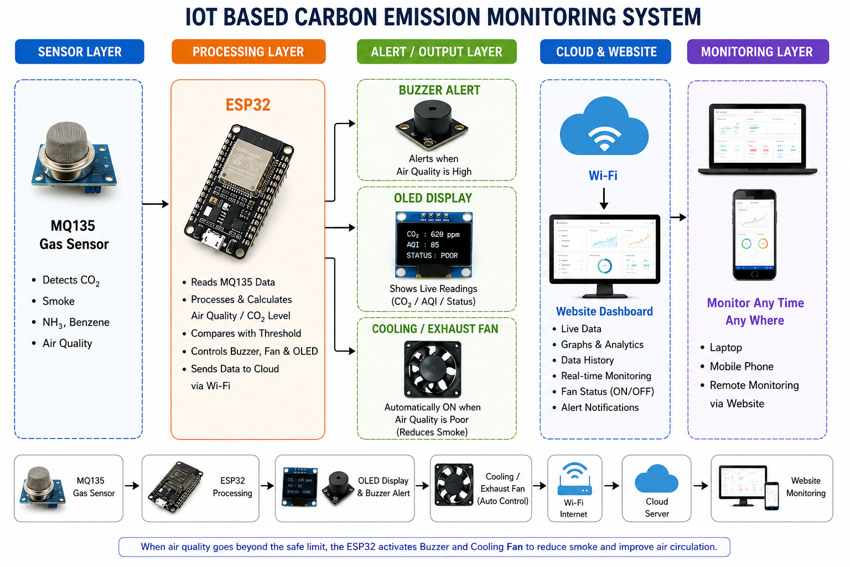
7.Expected Outcome
Working Prototype – A functional ESP32-based unit that continuously measures air pollutant levels and carbon dioxide concentration at a campus location.
Real-Time Alerts – Instant on-site indicator and a notification with the node's location sent to the campus dashboard the moment air quality or carbon levels turn unsafe.
Reduced Manual Monitoring – Fewer routine manual air-quality surveys, since staff are notified only when readings cross unsafe thresholds.
Healthier Campus Environment – Early warning of poor air quality and rising carbon emissions supports timely ventilation, traffic, and green-space decisions on campus.

Slide 15
8.SDG Number and Global Challenge
SDG Number:
SDG 13 – Climate Action
Global Challenge & Relevance:
Reducing Air Pollution and Emissions – Continuous monitoring helps the campus identify pollution hotspots and cut carbon emissions from vehicles, labs, and buildings.
Improving Public Health and Well-being – Timely alerts let campus administration act before poor air quality affects students and staff, supporting SDG 11 (Sustainable Cities and Communities).
Supporting Smart, Sustainable Campuses – A low-cost, IoT-based monitoring approach makes it practical for institutions to track and reduce their environmental footprint affordably.

Slide 16
9.Project Domain Mapping with POs / PSOs with justification
Course Code | PO1 | PO2 | PO3 | PO4 | PO5 | PO6 | PO7 | PO8 | PO9 | PO10 | PO11 | PSO1 | PSO2
C308.1 | 3 | 3 | 1 | 1 | 1 | 1 | 1 | 1 | 1 | - | 1 | 2 | 1
C308.2 | 2 | 3 | 1 | 3 | 1 | 1 | 1 | 1 | 1 | - | 2 | 2 | 3
C308.3 | 2 | 2 | 3 | 2 | 3 | 1 | 3 | 2 | 1 | 1 | 1 | 3 | 2
C308.4 | 2 | 2 | 3 | 2 | 3 | 2 | 3 | 3 | 3 | 2 | 1 | 3 | 3
C308.5 | 1 | 1 | 1 | 1 | 1 | 1 | 1 | 2 | 3 | 3 | 2 | 2 | 2
C308 Avg. | 2.0 | 2.2 | 1.8 | 1.8 | 1.8 | 1.2 | 1.8 | 1.8 | 1.8 | 1.2 | 1.4 | 2.4 | 2.2
HIGH: 3; MEDIUM: 2; LOW: 1; NO CONTRIBUTION: –

Slide 17
10.Conclusion
The Real-Time Air Quality and Carbon Emission Monitoring System offers a low-cost approach to tracking campus air pollutants and carbon levels using gas, particulate, and CO2 sensors on a single ESP32-based unit.
It enables early detection of poor air quality and rising emissions before they affect student and staff health, allowing campus administration to act before conditions worsen.
By combining air-quality and carbon sensing with location-tagged alerts, the system pinpoints exactly which campus zone needs attention, cutting down manual inspection time.
The design supports a healthier campus environment by warning of unsafe air quality or carbon build-up before it impacts occupants of classrooms and labs.
Overall, the system provides a practical, scalable step toward smarter campus sustainability, supporting cleaner air and lower carbon emissions in line with SDG 13 and SDG 11.

Slide 18
11.References
Farrag, O. and Mansour, A. and Abed, B. and Abu Alhaj, A. and Landolsi, T. and Al-Ali, A.R. (2025) 'IVEMPS: IoT-Based Vehicle Emission Monitoring and Prediction System', IEEE Access, Vol.13, pp.95628-95646.
Rosa-Bilbao, J. and Butt, F.S. and Merkl, D. and Wagner, M.F. and Schafer, J. and Boubeta-Puig, J. (2025) 'IoT-Based Indoor Air Quality Management System for Intelligent Education Environments', IEEE Internet of Things Journal, Vol.12, No.11, pp.18031-18041.
Shihao, L. and Dahnil, D.P. and Saad, S. (2025) 'A Survey of Smart Campus Resource Information Management in Internet of Things', IEEE Access, Vol.13, pp.66622-66645.
Mowla, M.N. and Mowla, N. and Shah, A.F.M.S. and Rabie, K.M. and Shongwe, T. (2023) 'Internet of Things and Wireless Sensor Networks for Smart Agriculture Applications: A Survey', IEEE Access, Vol.11, pp.145813-145852.
Martinez, I. and Cano, E. and Marco, A. and Fernandez, A. (2026) 'IoT-Based Real-Time Monitoring Ecosystem on Smart Campus', Indoor Air (IEEE Indexed), Vol.2026, Article 9999782, 29 pp.
Gu, K. and Liu, Y. and Liu, H. and Liu, B. and Qiao, J. and Lin, W. and Zhang, W. (2025) 'Air Pollution Monitoring by Integrating Local and Global Information in Self-Adaptive Multiscale Transform Domain', IEEE Transactions on Multimedia, Vol.27, pp.3716-3728.
Zhang, Q. and Song, S. and Bai, M. and Wang, X. and Tang, L. (2025) 'Real-Time Monitoring Ozone by an Intelligent Sensor Terminal With Low Cost', IEEE Sensors Journal, Vol.25, No.2, pp.3230-3238.
Zhang, S. and Ji, H. and Zhang, W. and Yuan, Z. and Meng, F. (2024) 'Lightweight and Accurate Identification Model for Precursor Chemicals Based on Semiconductor Gas Sensor', IEEE Transactions on Instrumentation and Measurement, Vol.73, pp.1-11.
Acharyya, S. and Ghosh, A. and Nag, S. and Majumder, S.B. and Guha, P.K. (2024) 'Smart and Selective Gas Sensor System Empowered With Machine Learning Over IoT Platform', IEEE Internet of Things Journal, Vol.11, No.3, pp.4218-4226.
Hu, K. and Zhang, Q. and Gong, S. and Zhang, F. and Weng, L. and Jiang, S. and Xia, M. (2024) 'A Review of Anthropogenic Ground-Level Carbon Emissions Based on Satellite Data', IEEE JSTARS, Vol.17, pp.8339-8357.

